Slide 1

Airline Management System
CSYE 7374 - Design Patterns

Slide 2
TEAM MEMBERS
Name | NU ID | Contribution
Rakesh Soni | 2813450 | Integrated Builder and Decorator patterns for flexible flight and upgrade implementations.
Devansh Srivastava | 2272055 | Structured core design and implemented Factory and Singleton patterns.
Niraj Komalkant Malpani | 2849800 | Simplified data workflows using Facade and Bridge patterns for saving/loading and modular features.
Ujjawal Shrivastava | 2201611 | Enhanced system functionality with Observer and State patterns for dynamic behavior.
Naman Diwan | 2724115 | Designed and implemented Strategy and Prototype patterns for dynamic discounts and ticket cloning.
Mihir Dadwal | 2294525 | Implemented Command pattern for modular ticket booking and cancellation features.
Atharva Tiwari | 2824041 | Developed the Adapter pattern for multi-currency flight price conversions.

Slide 3
Design Patterns Implemented
Singleton
Factory
Builder
Facade
Strategy
Decorator
Adapter
State
Bridge
Prototype
Command
Observer

Slide 4
Program flow
Create Arline Object using the Singleton Factory
Import Data from CSV and save and load the data using Facade
Add another flight and customer to the list using Builder
Create a booking with a customer on a given flight
Builder
Apply available discount using Strategy
Apply Flight Upgrades using Decorator
The transaction is done after conversion to appropriate currency using Adapter
The states of flights are displayed using State Pattern
Applying for seat change and meal preferences using Bridge
Creating duplicate tickets using Prototype
Decoupling the sender and receiver using Command
Notifying state changes using Observer

Slide 5
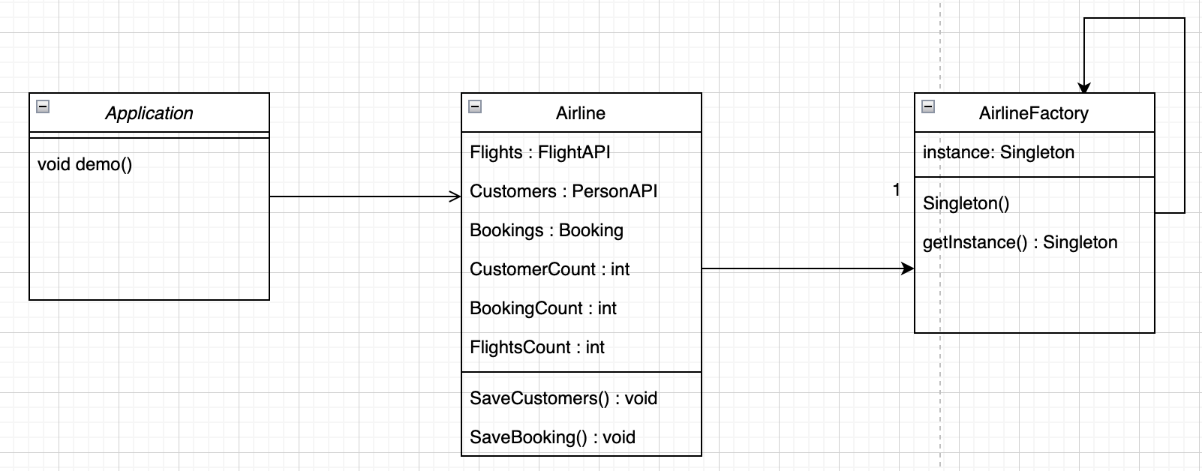
Singleton + Factory
The main method includes a call to the demo method
Within the demo method, an Airline object is created, which is provided by AirlineFactory
The AirlineFactory uses eager singleton pattern to produce the Airline object

Slide 6
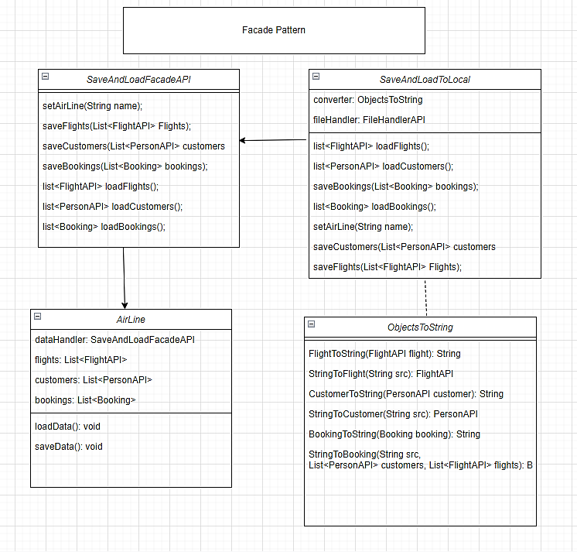
FACade
The complexities of saving and loading data when the program starts or stops are hidden from the user
Various methods of saving and loading data can be easily implemented by using the SaveAndLoadFacadeAPI
The project includes an implementation that allows saving and loading data into CSV files
An instance of the SaveAndLoadFacadeAPI implementation is integrated in AirLine object

Slide 7
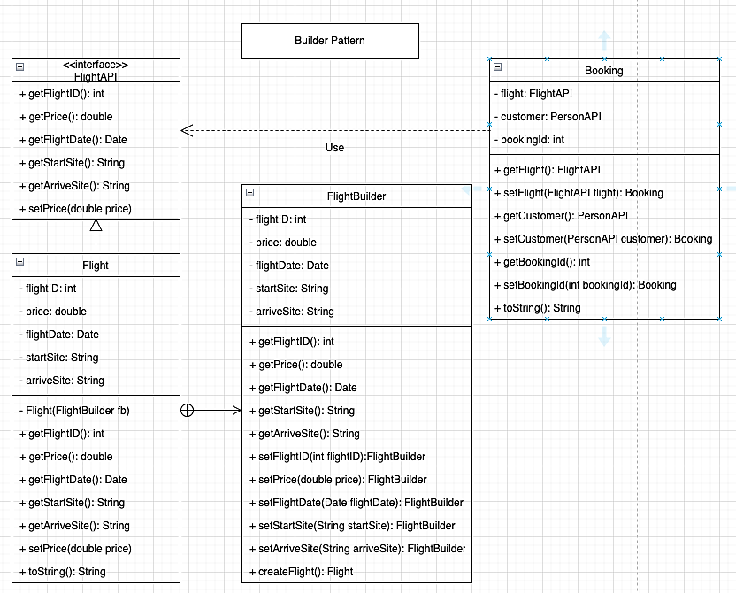
Builder
The Flight class delegates the creation of its objects to the FlightBuilder class. This allows the same construction process to produce various representations, simplifying the extension and variation of the internal structures of flights.
The Flight object is ultimately created by the createFlight() method

Slide 8
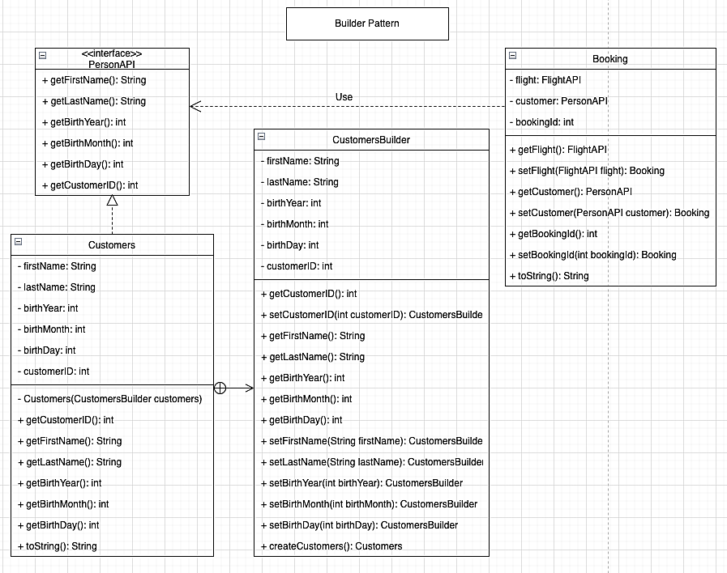
Builder
The PersonAPI provides an interface for various classes to implement. If the Observable pattern is introduced later, the Subscribers class can also implement PersonAPI
The Customers class hands over the responsibility of object creation to the CustomersBuilder class, which aids in extending and diversifying the internal representations of customers
The Customers object is ultimately created using the createCustomers method

Slide 9
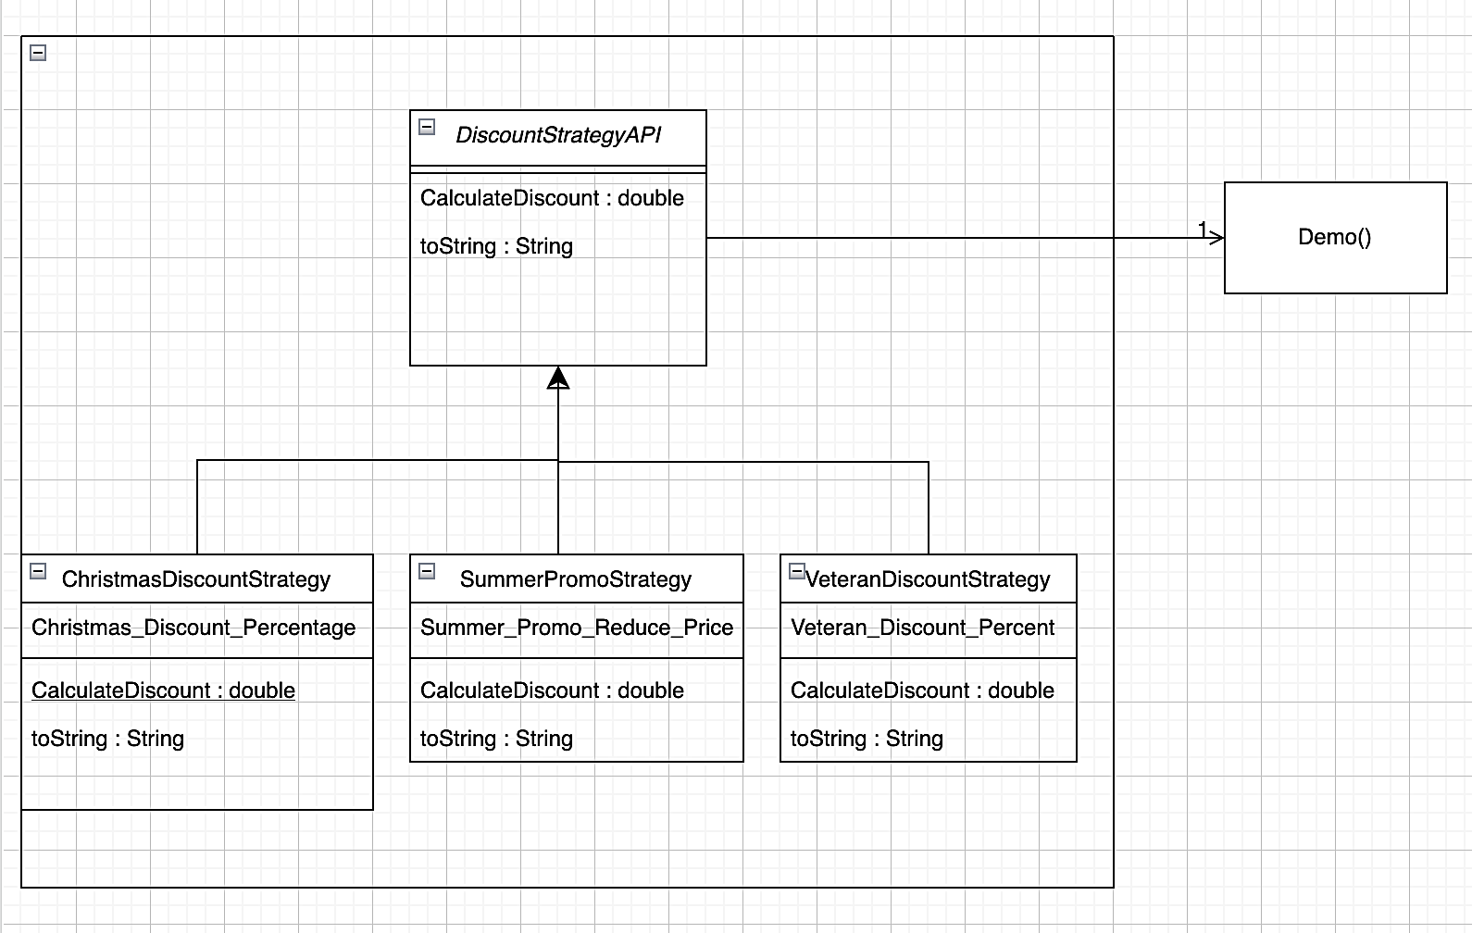
Strategy
The family of Discount Strategy Algorithms are interchangeable and the DiscountStrategyAPI specified by super class for abstraction
The airline price is passed as an argument to the CalculateDiscount function, which applies the specified percentage and returns the discounted price
The strategy can be modified during runtime.

Slide 10
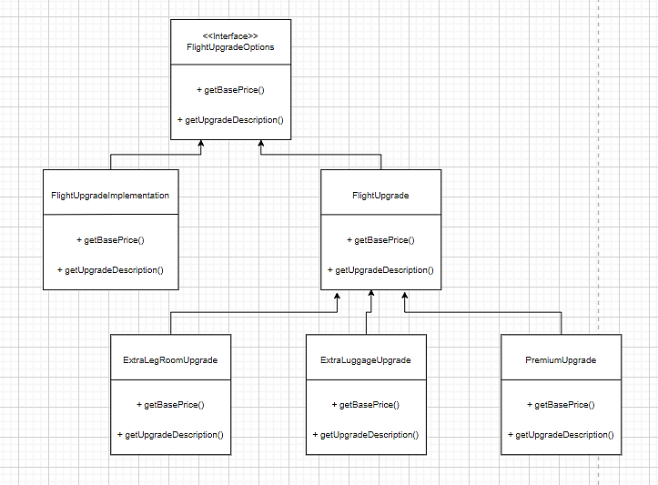
Decorator
The FlightUpgradeOptions interface is used to define methods that decorators will override when implementing it
An instance of FlightUpgrade contains the base price and description, which are passed to the decorator methods for modifications
FlightUpgradeImplementation retrives the base price and description
Decorators include:
ExtraLegRoom
ExtraLuggage
PremiumUpgrade

Slide 11
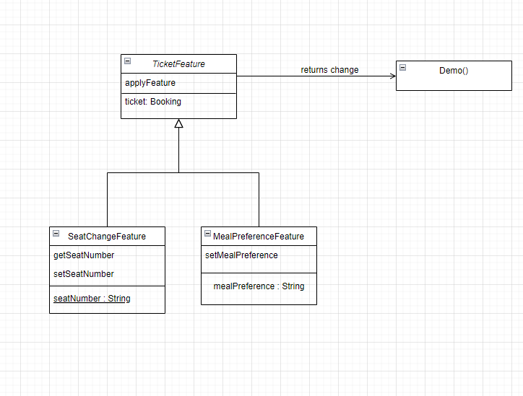
Bridge
The Bridge pattern separates abstraction (TicketFeature) from implementation (SeatChangeFeature and MealPreferenceFeature).
It allows for flexibility by enabling independent variation of abstraction and implementation hierarchies.
The pattern facilitates extending functionality without modifying existing code, as seen with the Demo class interaction.

Slide 12
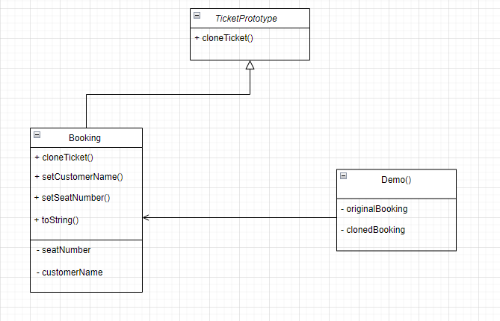
PROTOTYPE
TicketPrototype interface defines the cloneTicket() method that concrete prototype classes will implement
An instance of Booking serves as the concrete prototype, implementing cloneTicket() to provide a copy of itself.
The Booking class includes:
cloneTicket(): Implements cloning by calling super.clone().
Client creates an original Booking object, clones it using cloneTicket(), and modifies the cloned instance.

Slide 13
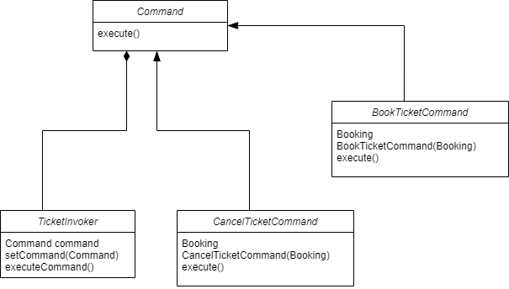
COMMAND
Command interface defines the execute() method that concrete command classes will implement.
Instance of Booking contains methods bookTicket() and cancelTicket() which are invoked by command objects
Concrete command classes include:
BookTicketCommand: invokes bookTicket()
CancelTicketCommand: invokes cancelTicket()
Client creates instances of BookTicketCommand and CancelTicketCommand, sets them in the TicketInvoker

Slide 14
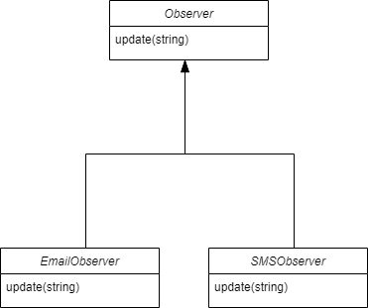
Observer
The Observer pattern defines a one-to-many dependency between objects, where multiple observers are notified of changes in a subject's state.
It consists of an abstract Observer class and concrete observer implementations (EmailObserver and SMSObserver in this case).
The pattern allows for loose coupling between the subject and its observers, enabling easy addition or removal of observers without modifying the subject.

Slide 15
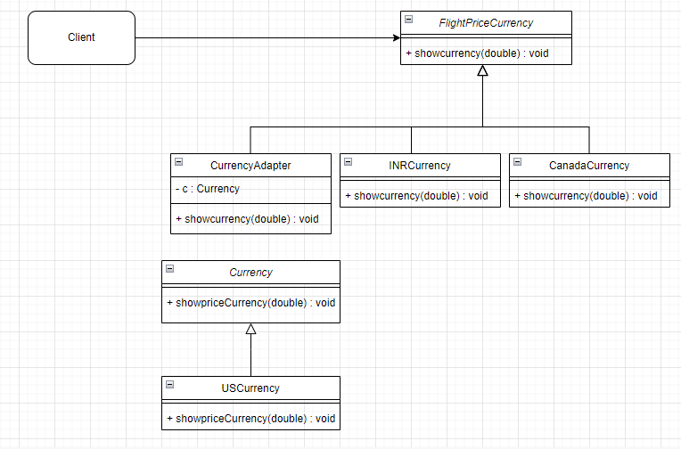
Adapter
The client can view flight prices in various currencies, including INR, Canadian Dollars or US Dollars
The CurrencyAdapter contains an instance of the Currency interface to adapt the currency
The CurrencyAdapter conceals the use of the adapted (Legacy API) code that provides flight prices in US dollars

Slide 16
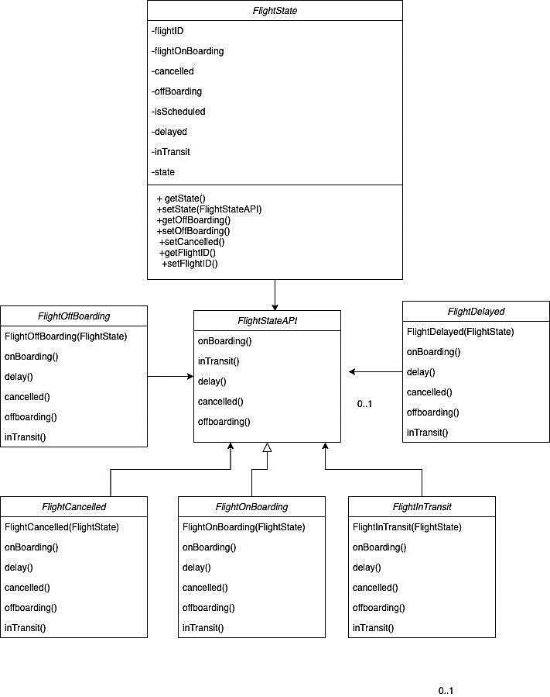
State
The Flight state object alters its behavior depending on its current internal state
The FlightStateAPI defines the methods that each state of the flight must implement
The possible states of the flight include: Scheduled, OnBoarding, InTransit, OffBoarding, Delayed, Cancelled

Slide 17

Future Enhancements and Lessons Learned
Future Enhancements:
Real-Time Data Sync: Integrate with live APIs for flight availability and pricing.
Database Integration: Replace CSV with a robust database for better scalability.
Mobile Support: Build a mobile application for customer convenience.
Enhanced UX/UI: Develop a graphical interface for better user interaction.
Multi-Language Support: Offer localization for international customers.
Lessons Learned:
Team Collaboration: Effective communication is critical for modular development.
Design Principles: Using design patterns simplifies complex systems.
Testing and Debugging: Importance of unit testing for reliability.
Flexibility: Patterns like Strategy and Observer enhance system adaptability.
Version Control: Git workflows streamlined teamwork and conflict resolution.

Slide 18

Thank You ANY QUESTIONS/COMMENTS/CONCERNS?

